Slide 1
Essential Skills in
using the tidyverse
Marieke K Jones, PhD
Research Data Specialist
Claude Moore Health Sciences Library
University of Virginia

Slide 2
Why R?
R is free
R is flexible
R is everywhere
R is awesome
$0
10K+ packages
50K+ downloads monthly

Slide 3



R is everywhere
In the UVa and Charlottesville communities:
useRs
Cville Data Science Meetup

Slide 4
R is awesome!

Slide 5
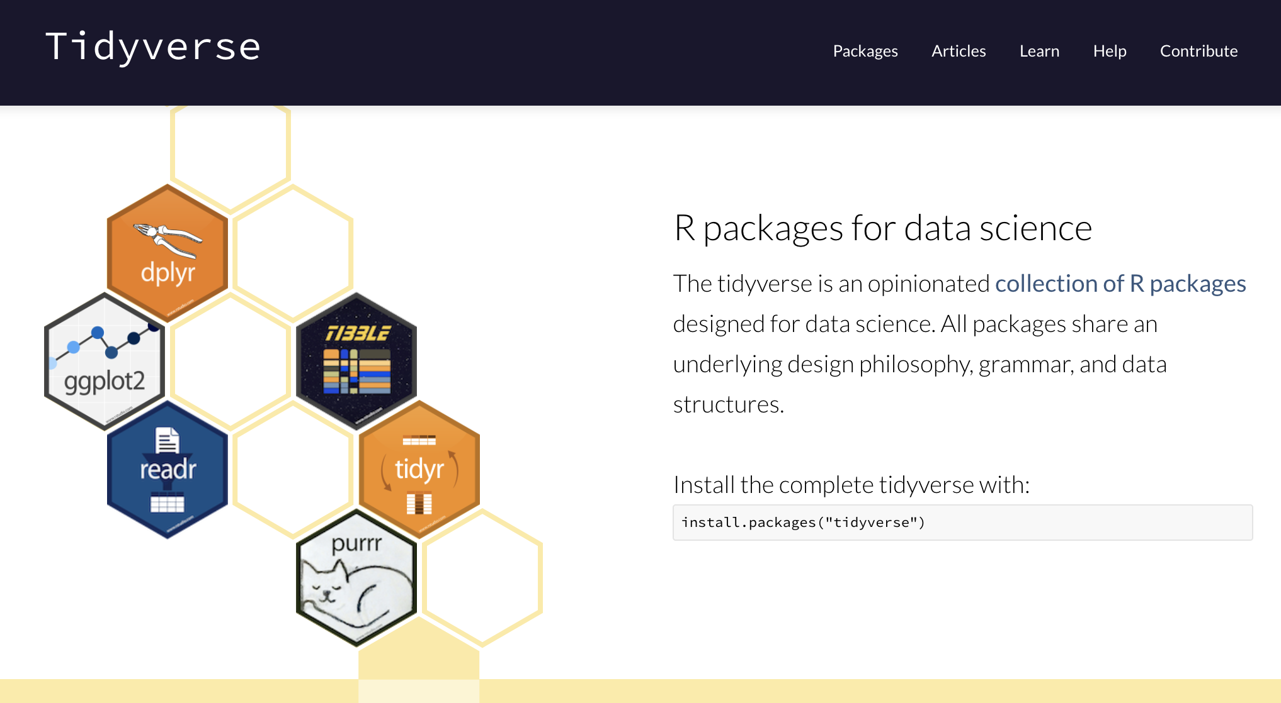
What is the tidyverse?

Slide 6
Something for everyone
R basics
Data manipulation using dplyr verbs
The power of the pipe %>%
Graphing with ggplot2

